Slide 1
Loop Controllers for Vehicle Detection
By: Michael Sisk

Slide 2
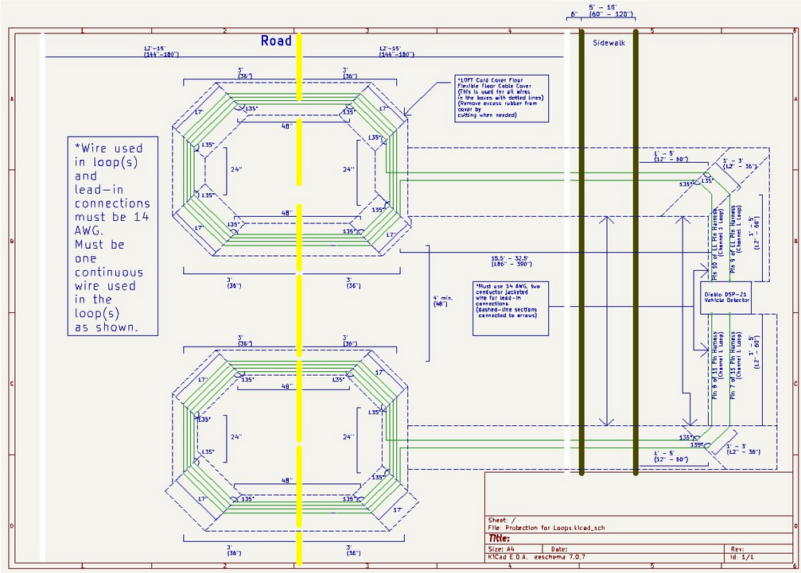

Slide 3
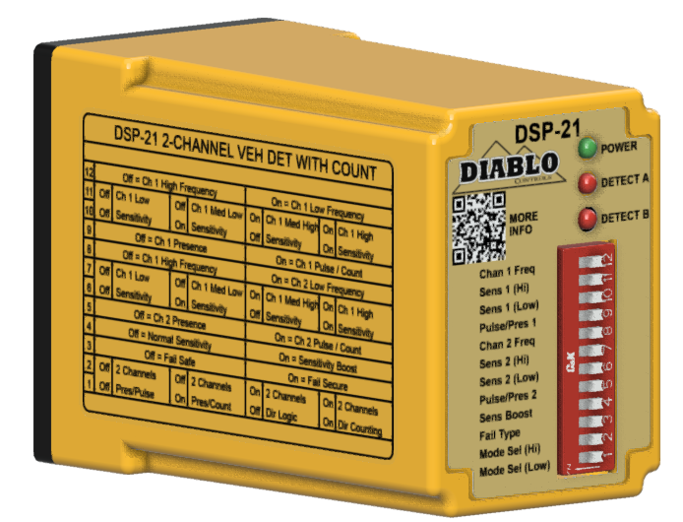
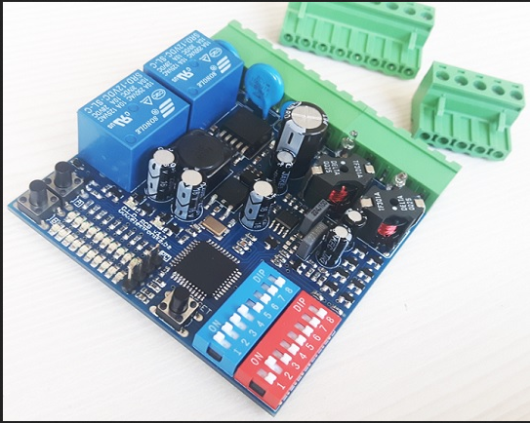
Examples of Loop Controllers

Slide 4
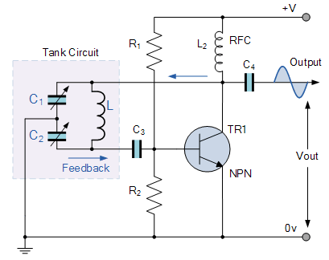
Loop Controller
Loop Controller consists of two circuits: Colpitts Oscillator and Sine to Square Wave
Colpitts Oscillator
Consists of a capacitive voltage divider and an inductor (inductive loop) that generates a stable frequency

Slide 5
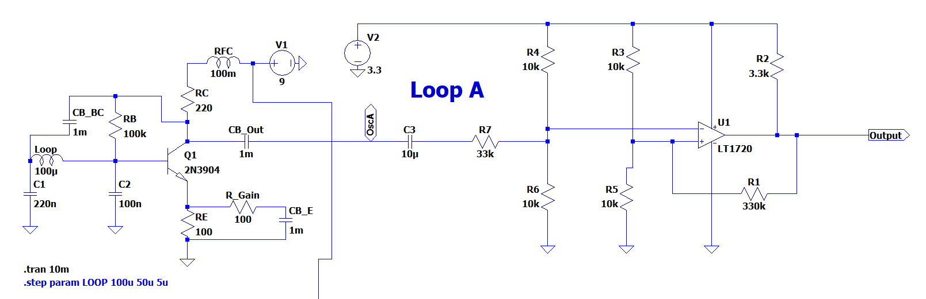
Loop Controller cont.

Slide 6

Loop Controller Frequency
The math
Set values: L = 100 µH, C1 = 220 nF, C2 = 100 nF
f0 = 60 kHz

